Slide 1
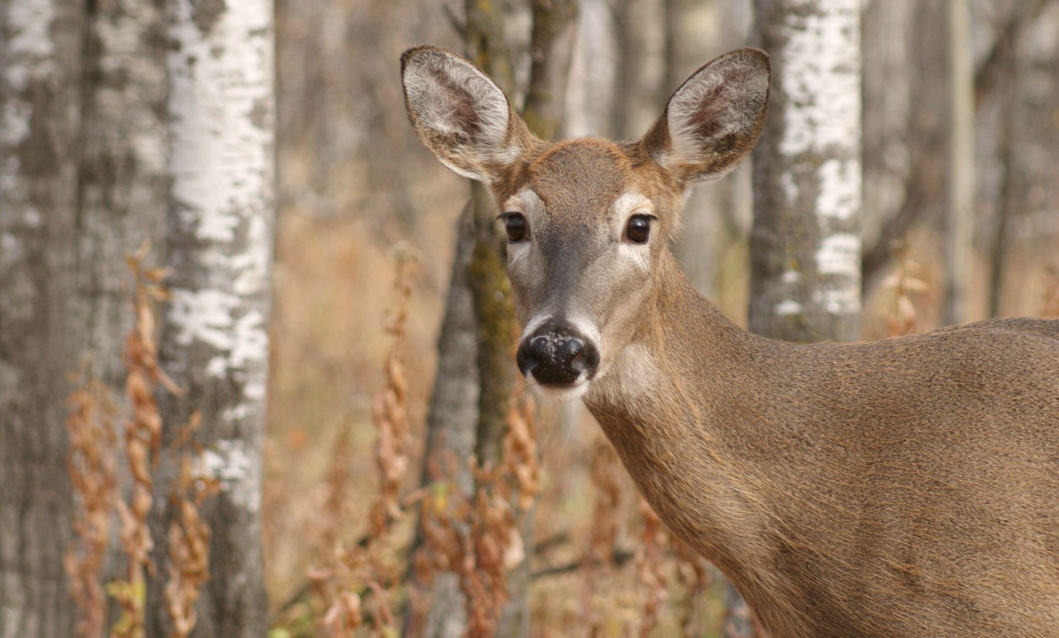
HUNGRY HUNT
Project

Slide 2
A Food Wastage Reduction is an app any user in need can see all the food items donated by different users and add them to his or her cart to deliver them to the needy person. • Wasting food is a common problem in our society. Food waste management is crucial since it can improve our environmental and economic sustainability. We have identified the use of mobile technology to reduce food waste management and built an android mobile application that allows individual user or restaurants to donate and share their foods and leftovers with people in need

Slide 3

SOFTWARE REQUIREMENTS:
Android Studio
Xml
Material Design
Java
FireBase

Slide 4
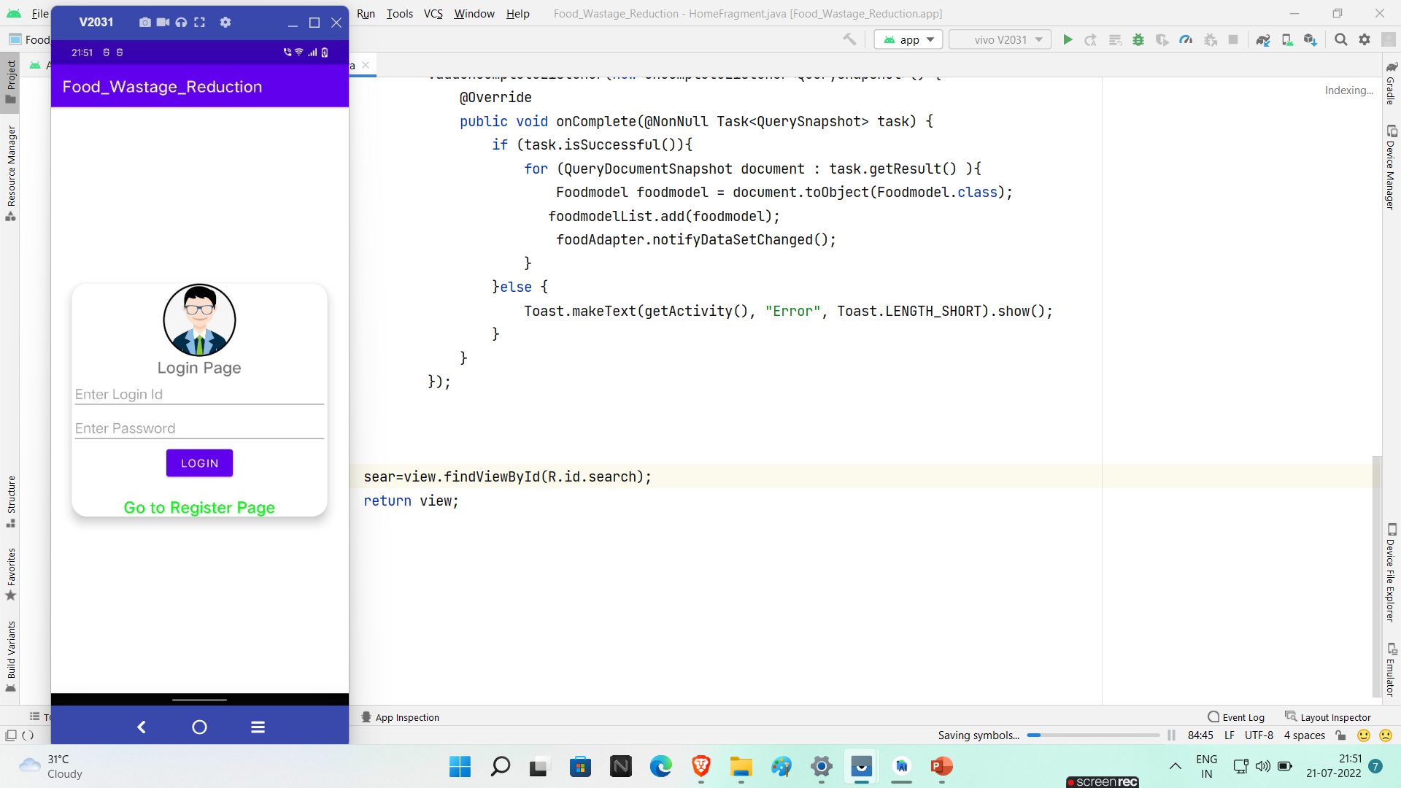
Login Page

Slide 5
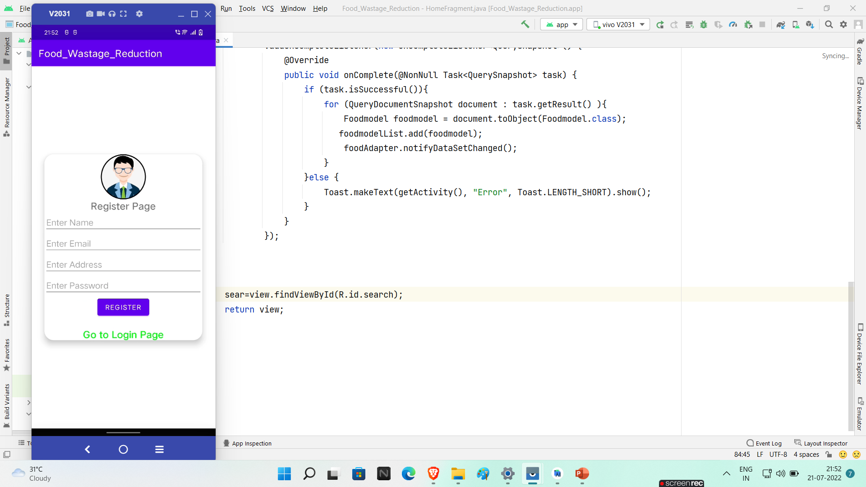
Register Page :-

Slide 6
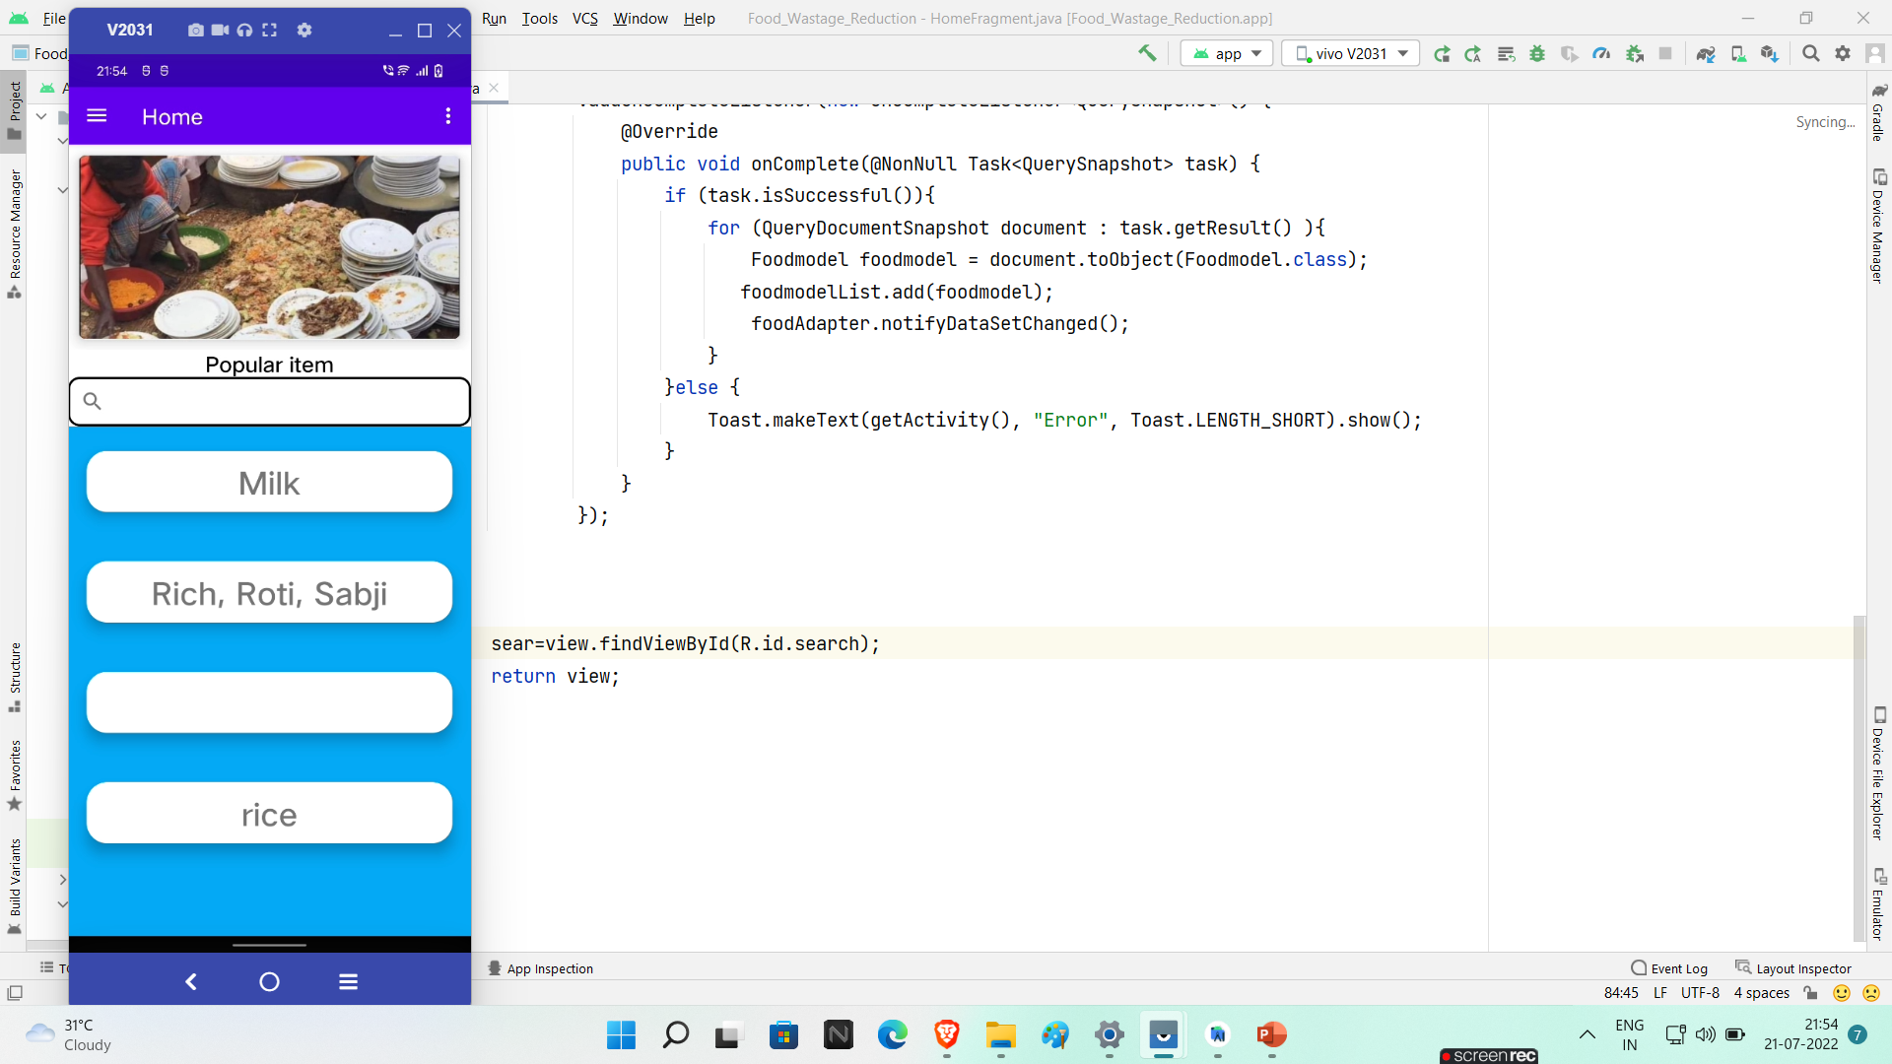
Sliding Page :-

Slide 7
Food List:-

Slide 8
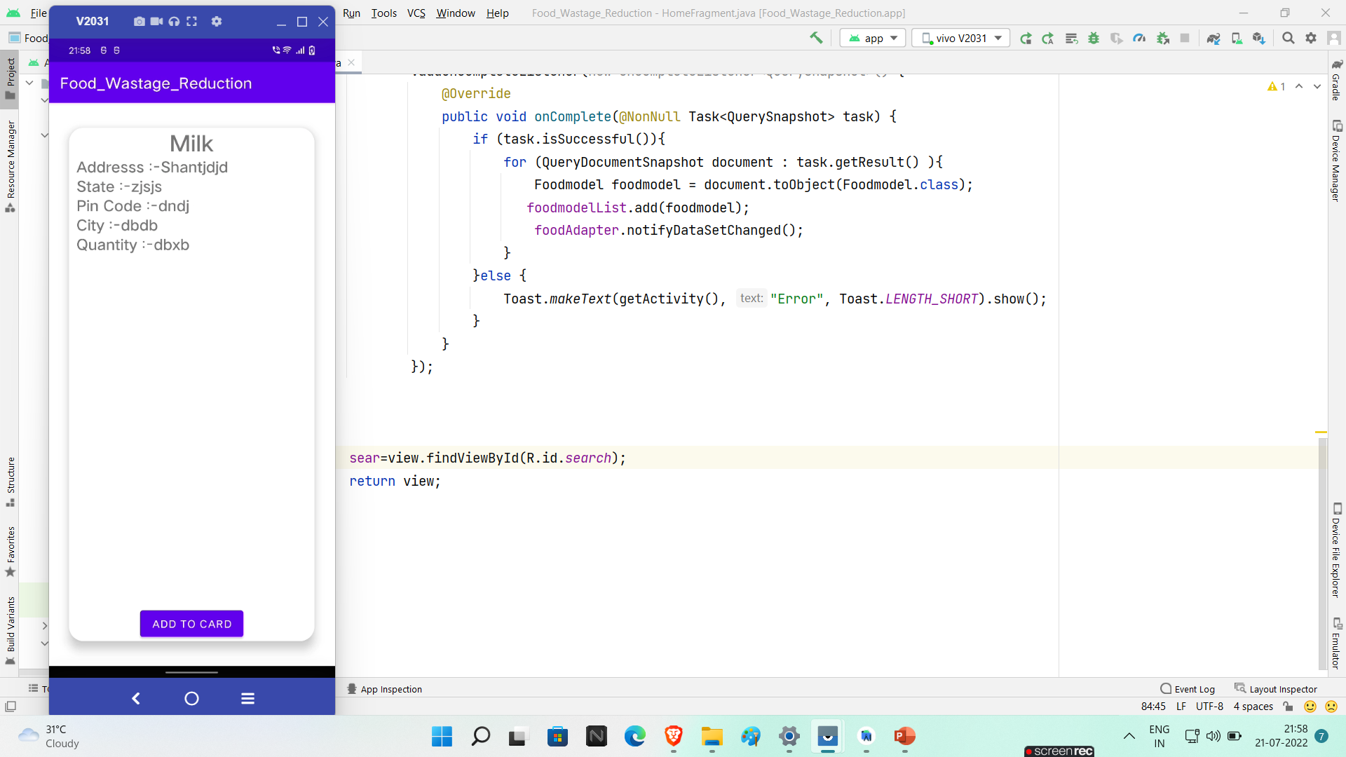
Food Detail

Slide 9
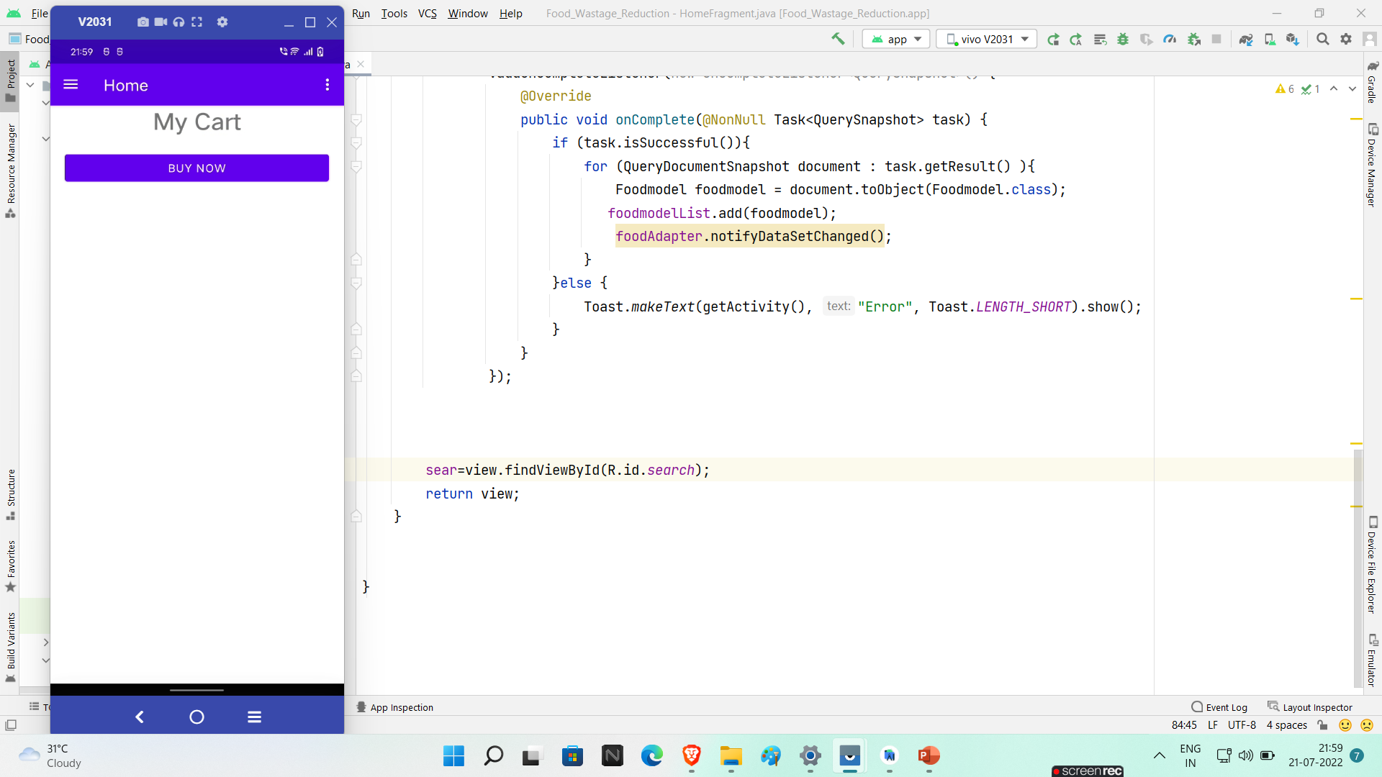
My Cart

Slide 10
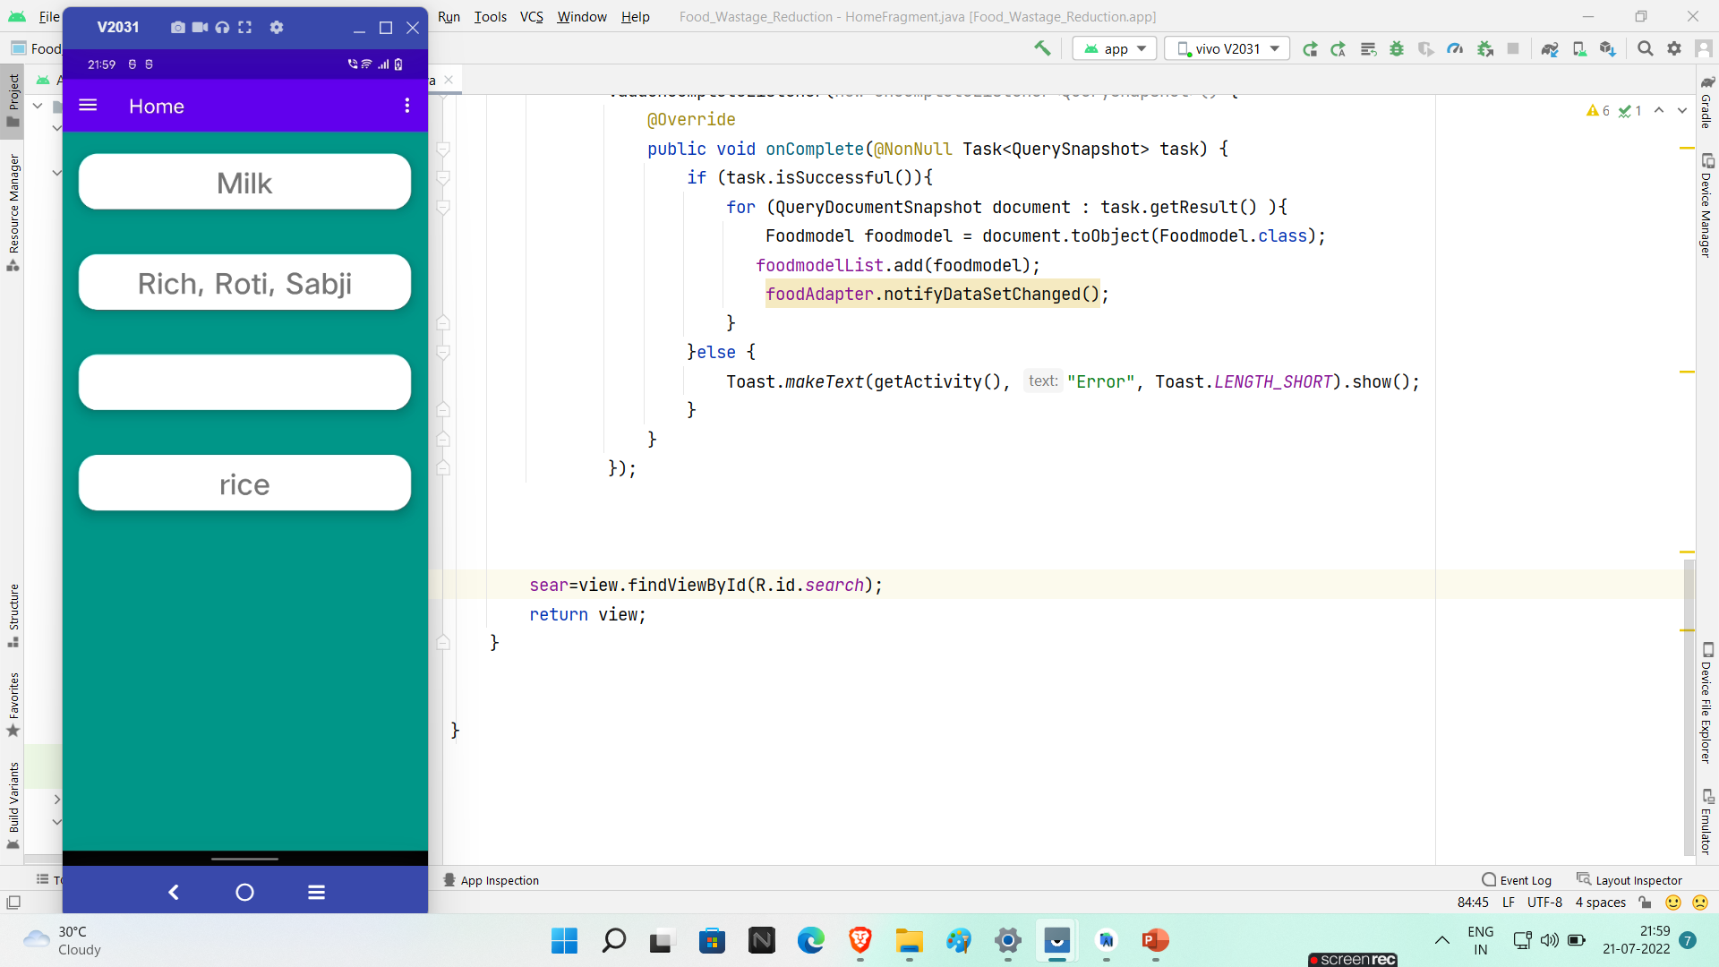
New Order

Slide 11
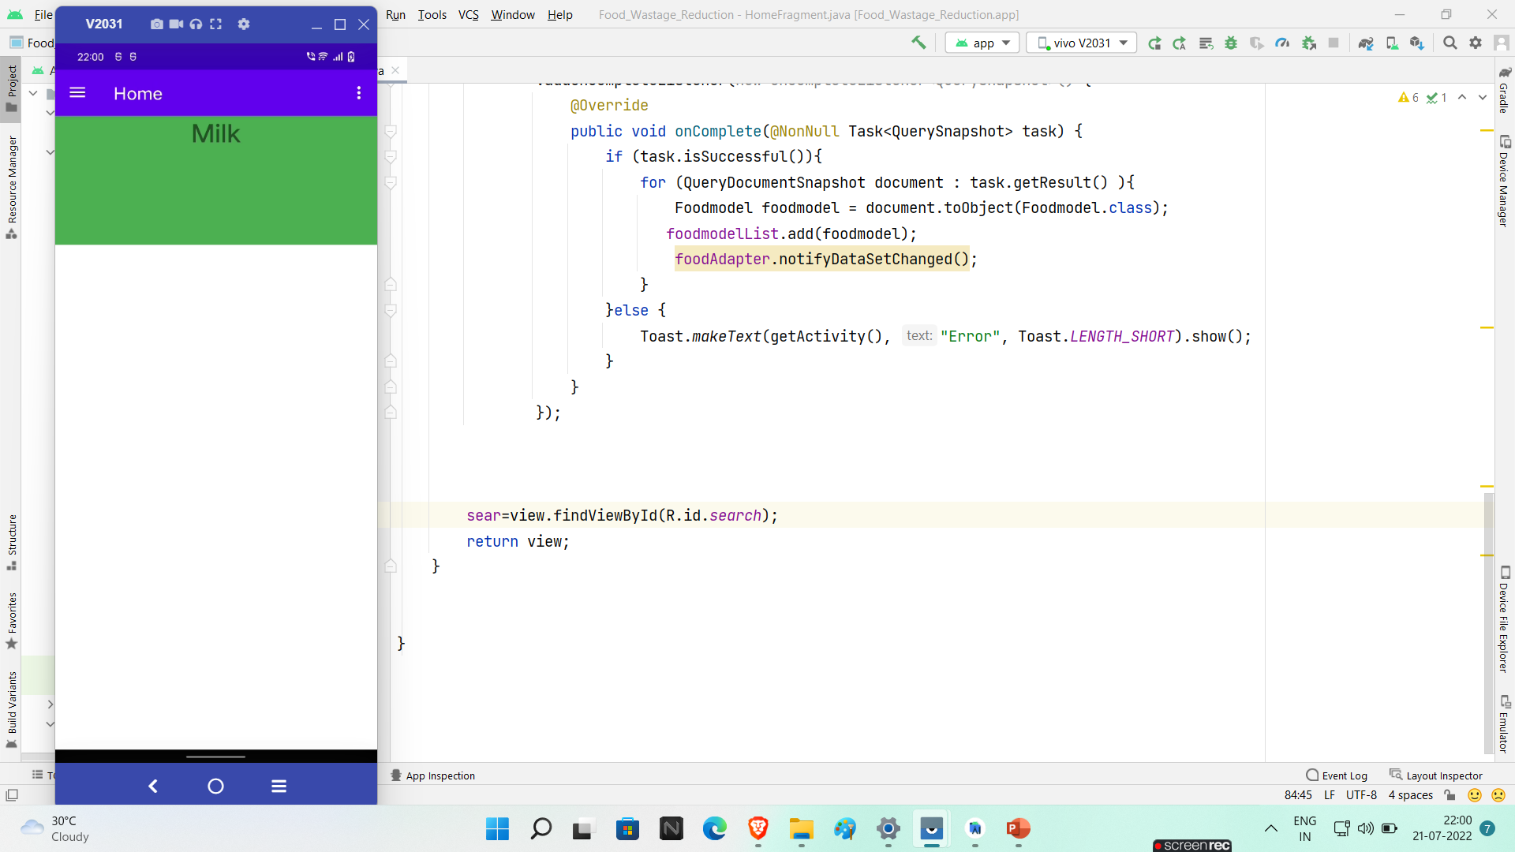
My Order

Slide 12
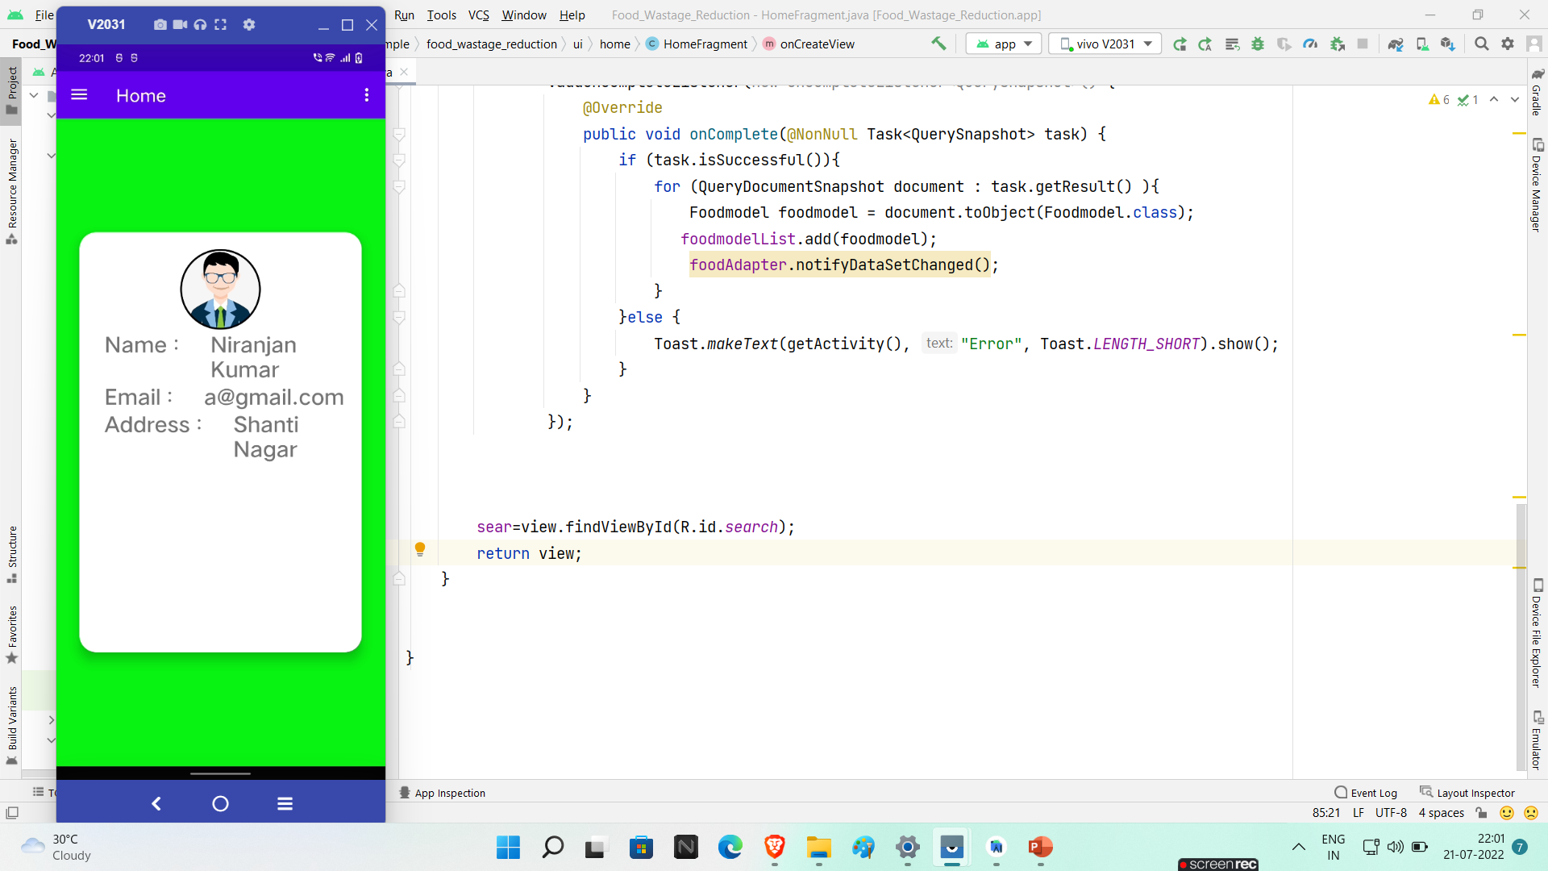
My Profile

Slide 13
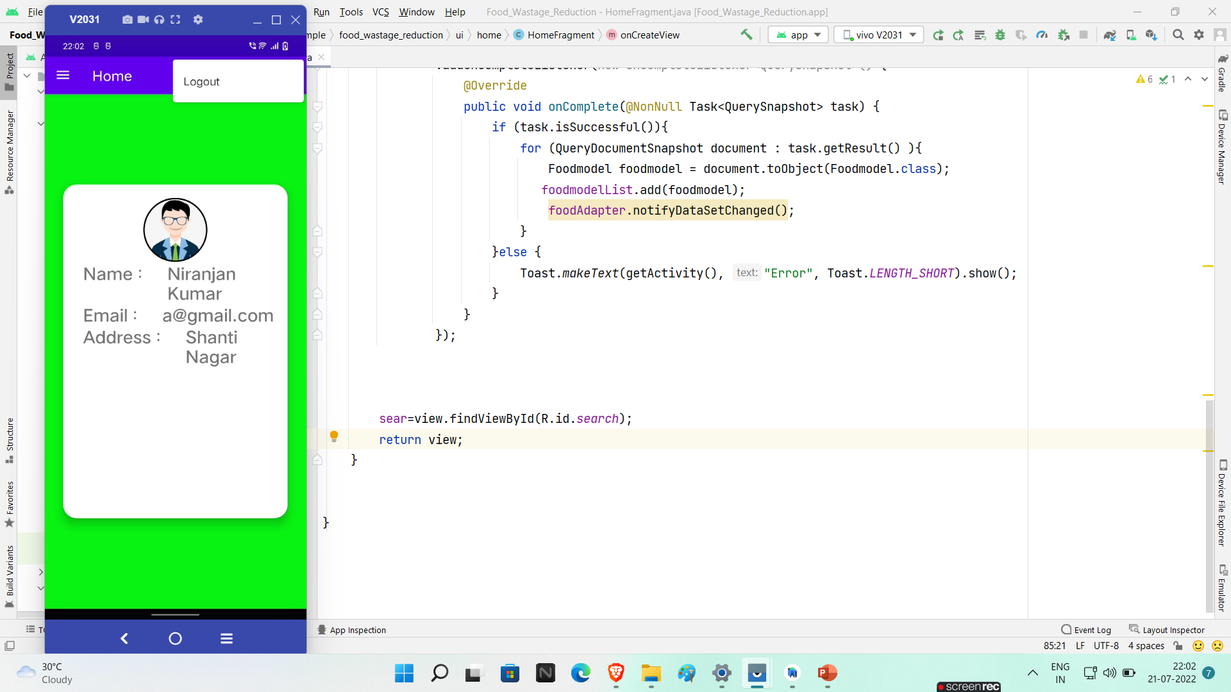
Logout

Slide 14
Thank-You

